Slide 1
FEDERAL DEBT CRISIS IS LOOMING
2025

Slide 2
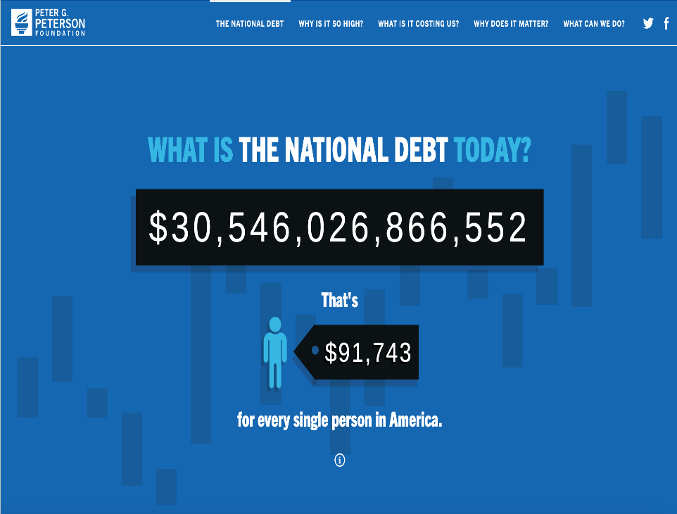
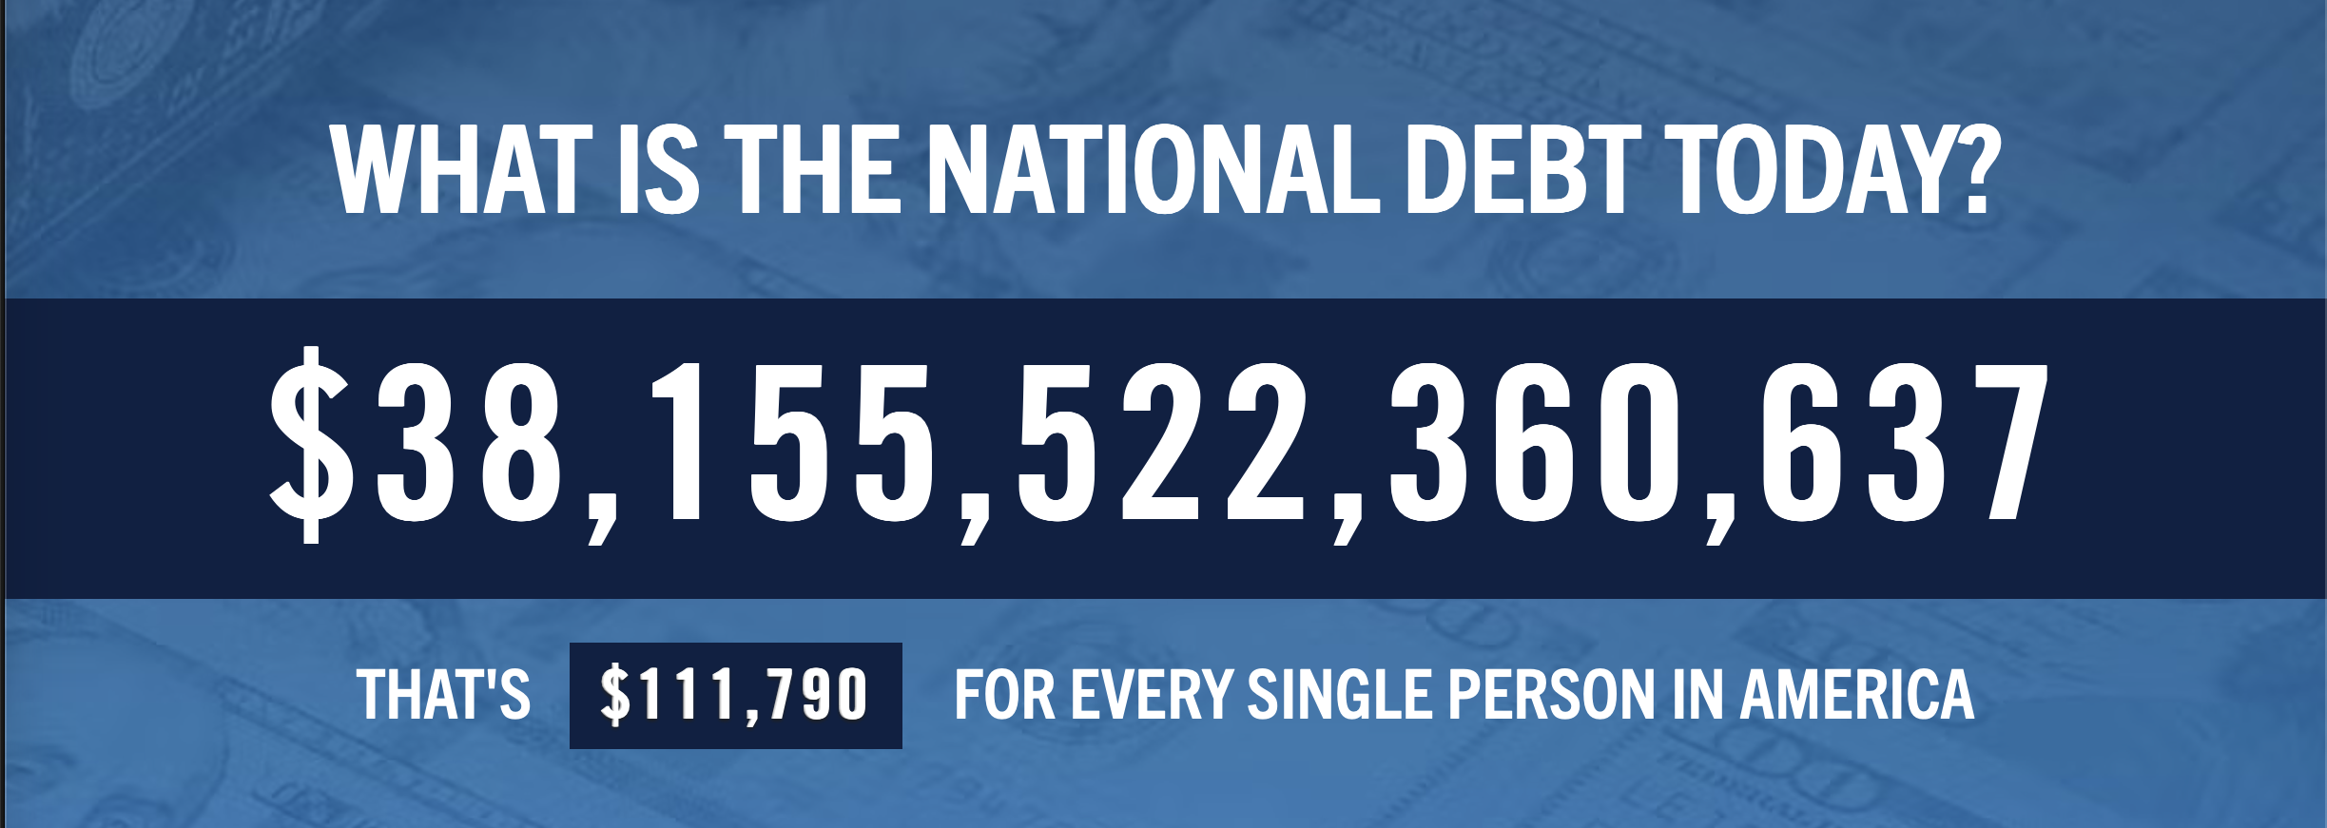
Notes:
As of Nov. 17, 2025, the National Debt is $38,207,302,333,902. That’s $111,114 for every person in America.

Slide 3

Notes:
As of Nov. 2025, US Federal Debt to GDP Ratio is 121.01%.

Slide 4
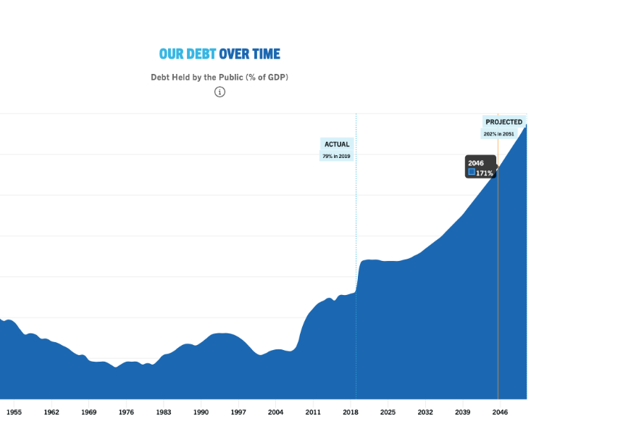
Notes:
From CBO, FY 2024 – 97.4% to 99.8% in FY 2025. Approximately twice the historic avg. of roughly 51% over past 50 years.

Slide 5
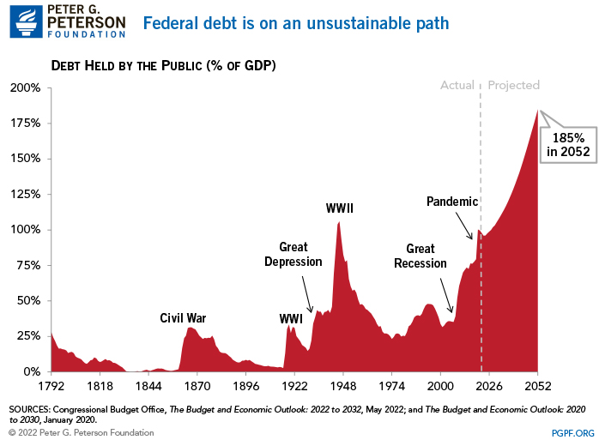

Slide 6
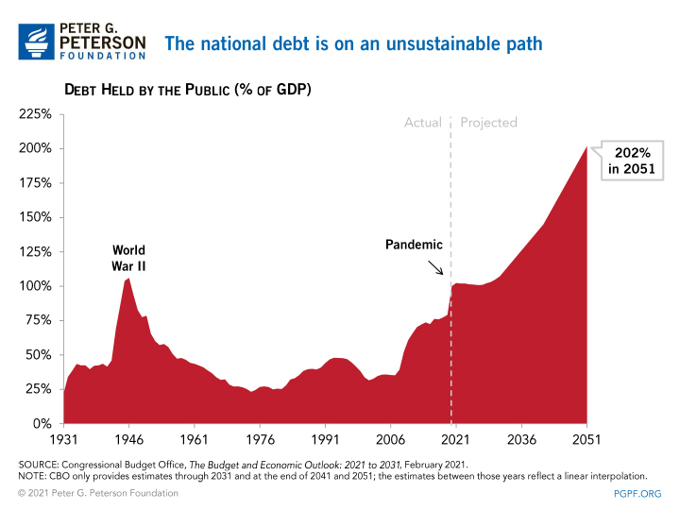

Slide 7


Slide 8
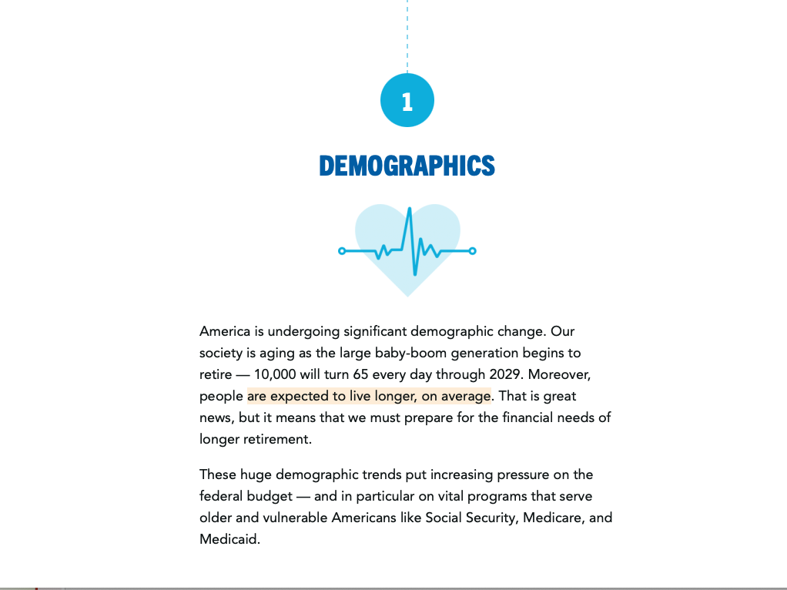

Slide 9
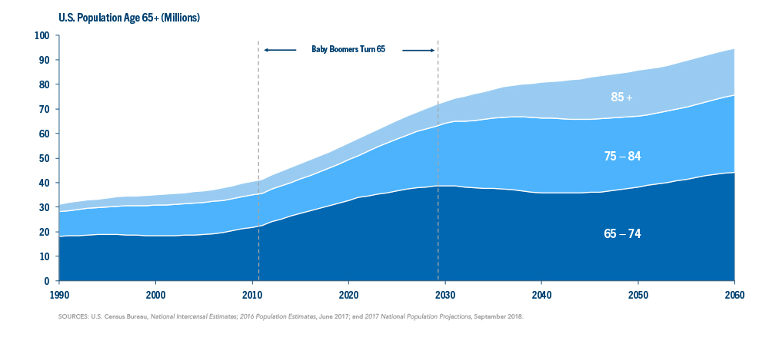

Slide 10


Slide 11
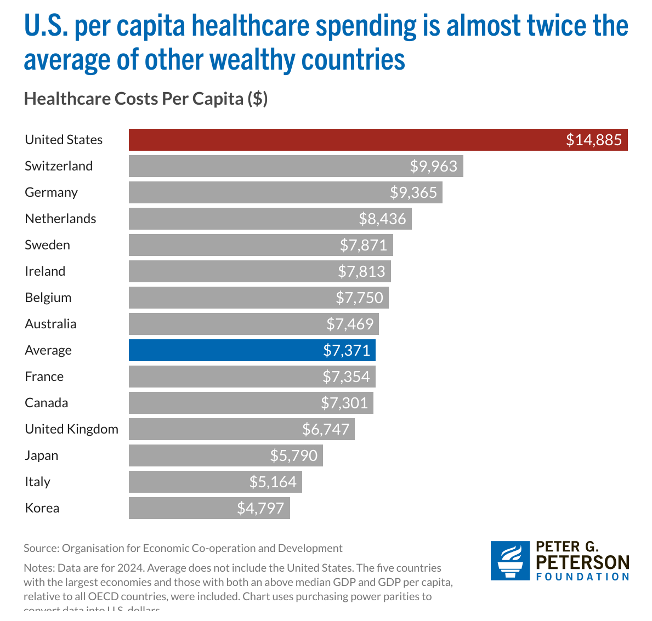
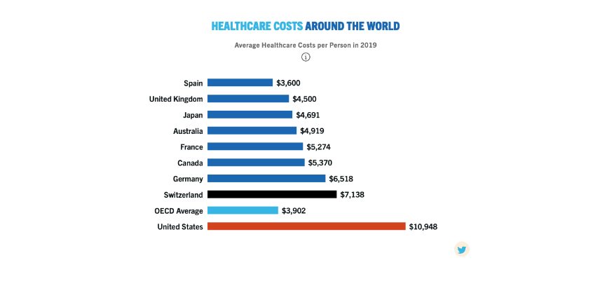

Slide 12
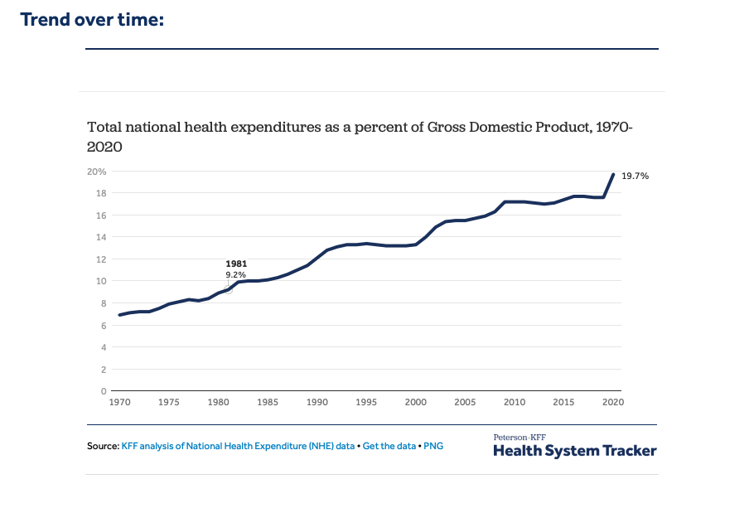
Notes:
Peterson Foundation 2025 projection approximately 18.5%. Centers for Medicare & Medicaid Services (CMS) projection approximately 20.1%

Slide 13
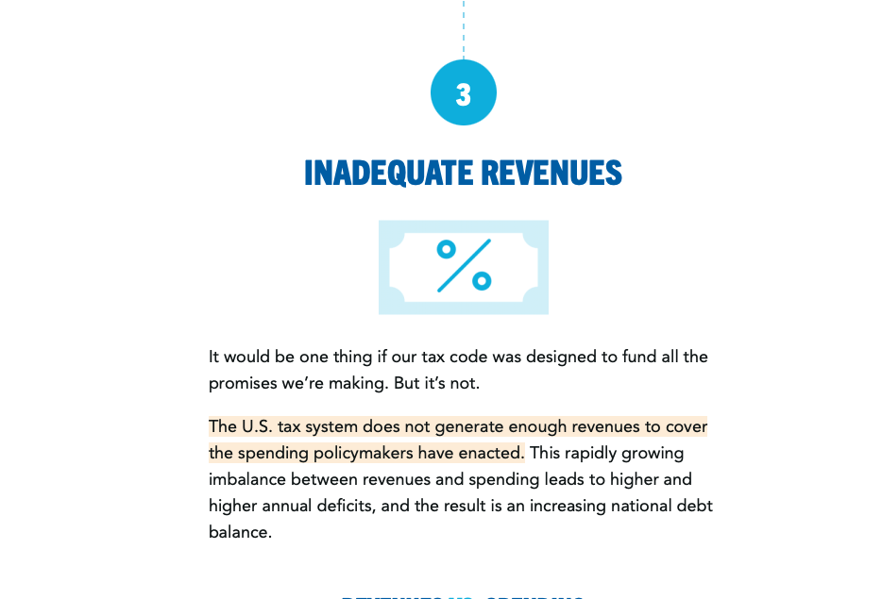

Slide 14
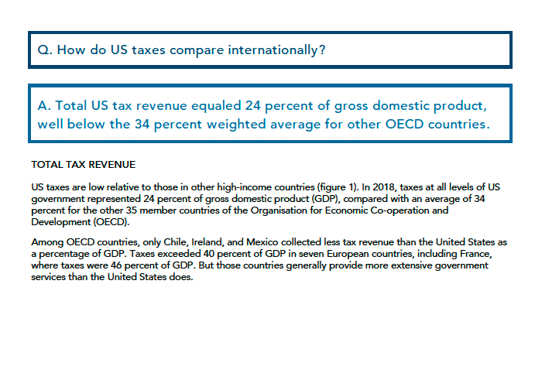
As of 2025 – OECD has 38 member countries

Slide 15
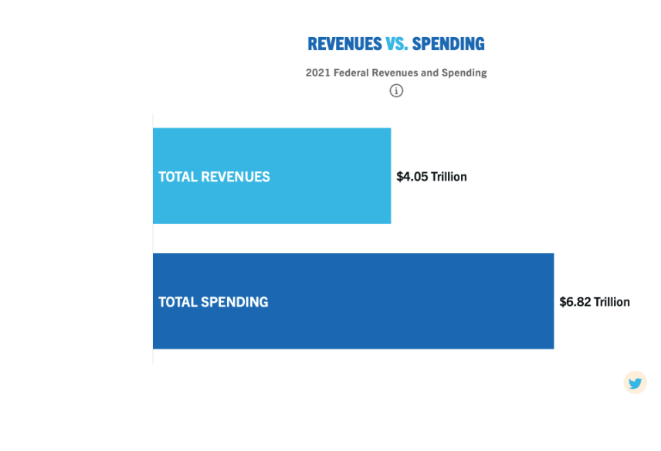
2025 - $5.23 Trillion
2025 -$7.01 Trillion

Slide 16
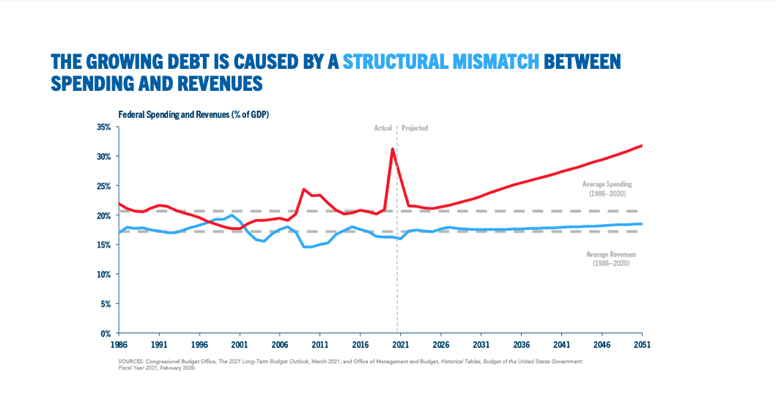

Slide 17
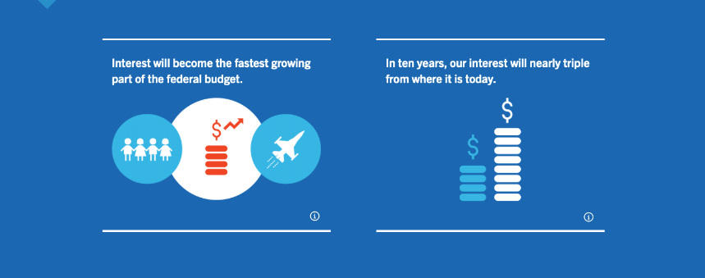

Slide 18
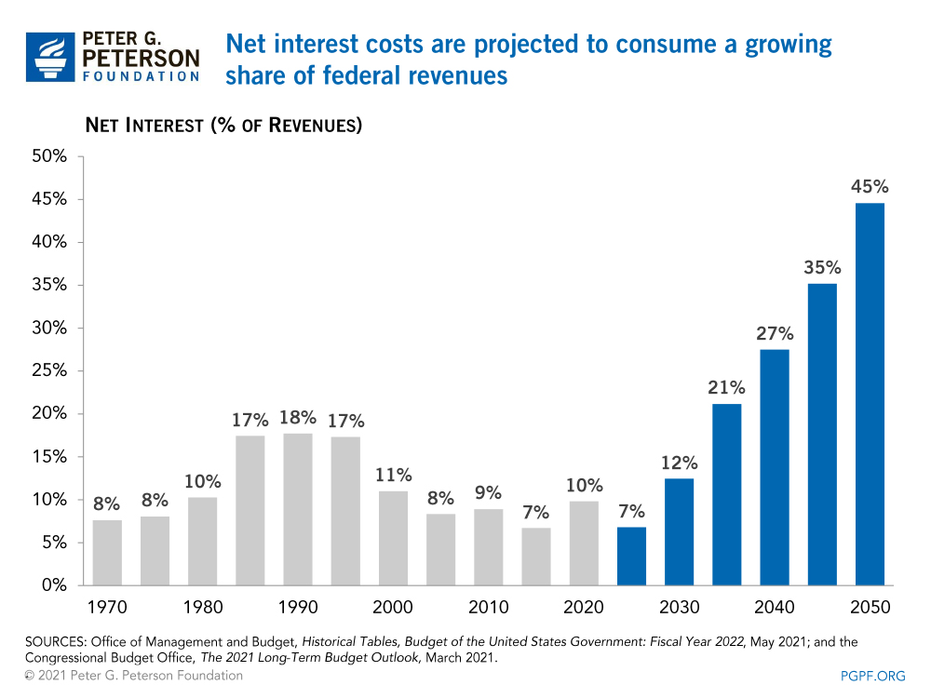

Slide 19
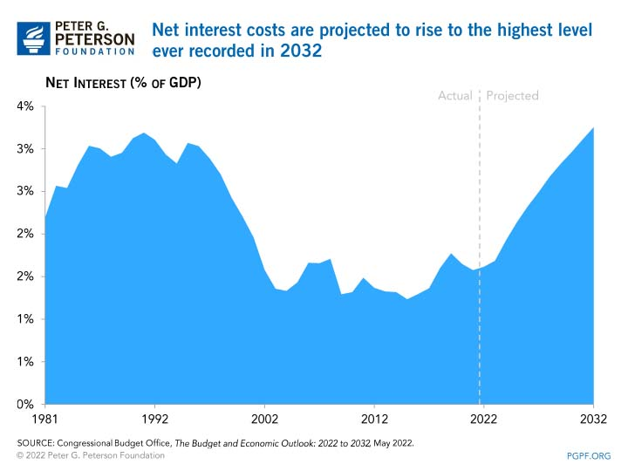

Slide 20
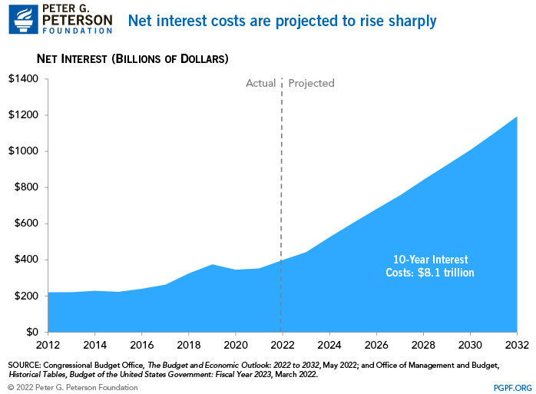

Slide 21
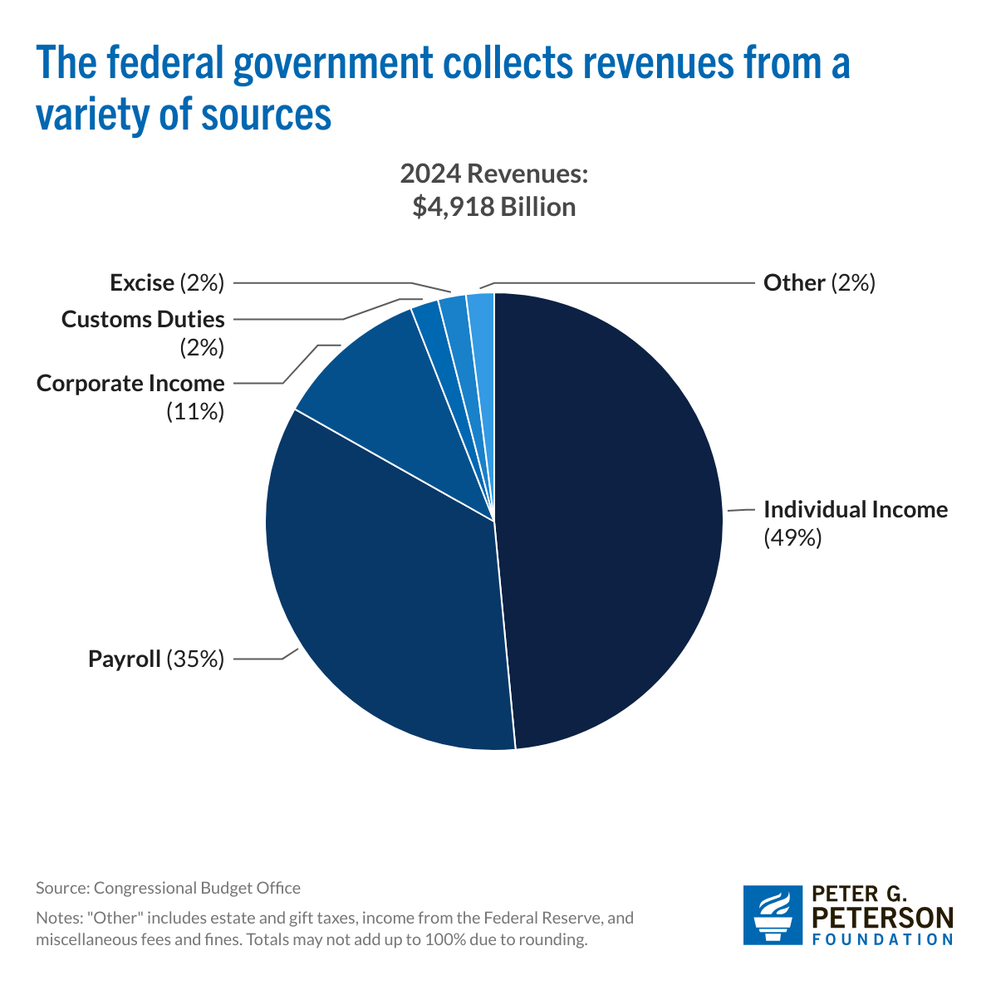
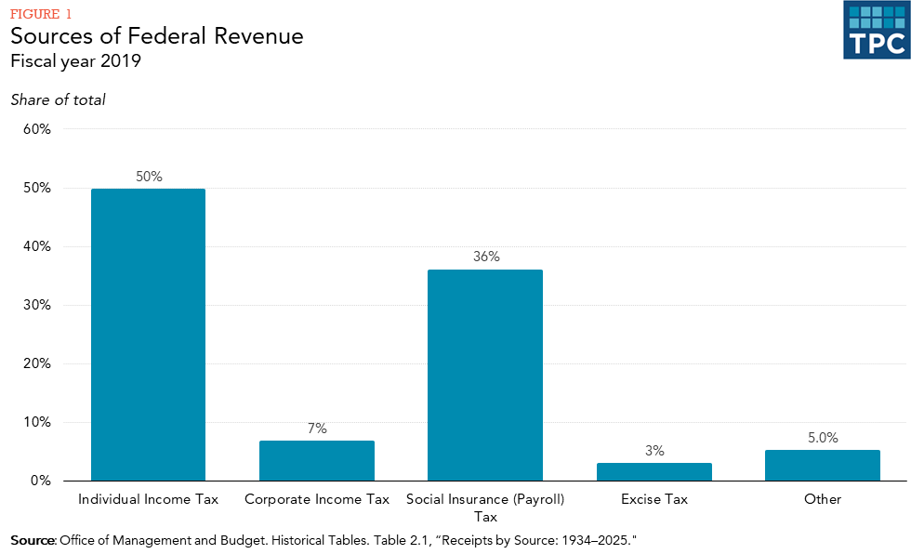

Slide 22
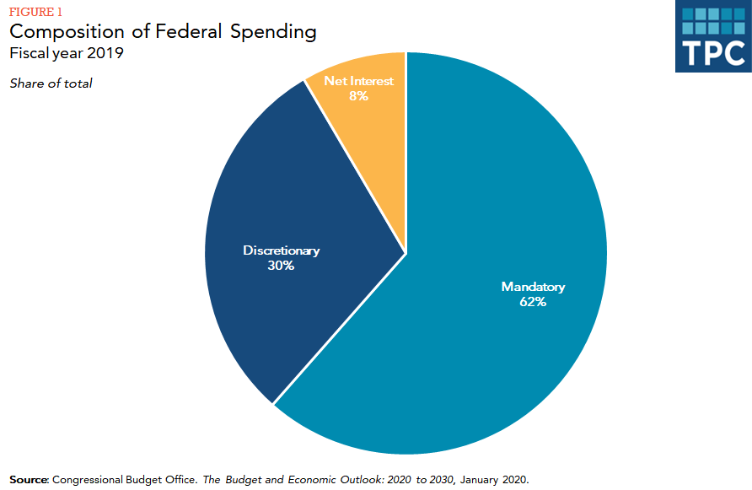
FY 2024 – 13%
FY 2024 – 27%
FY 2024 - 60%

Slide 23
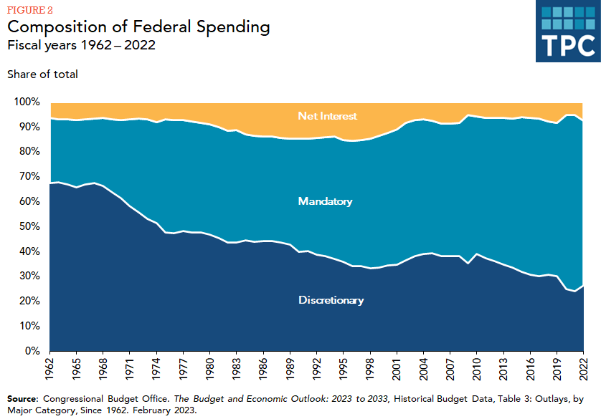
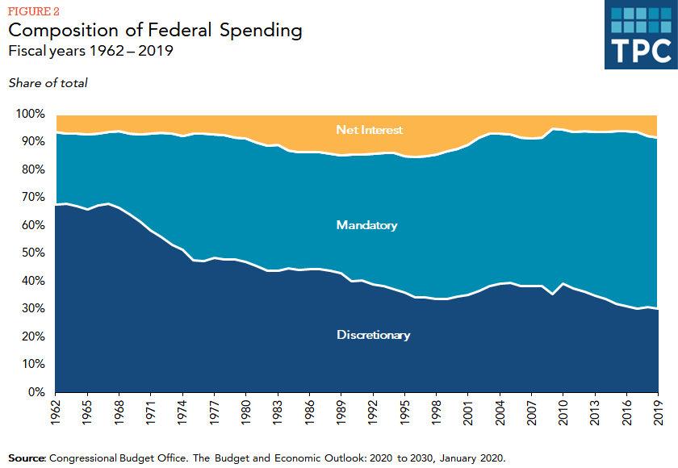

Slide 24
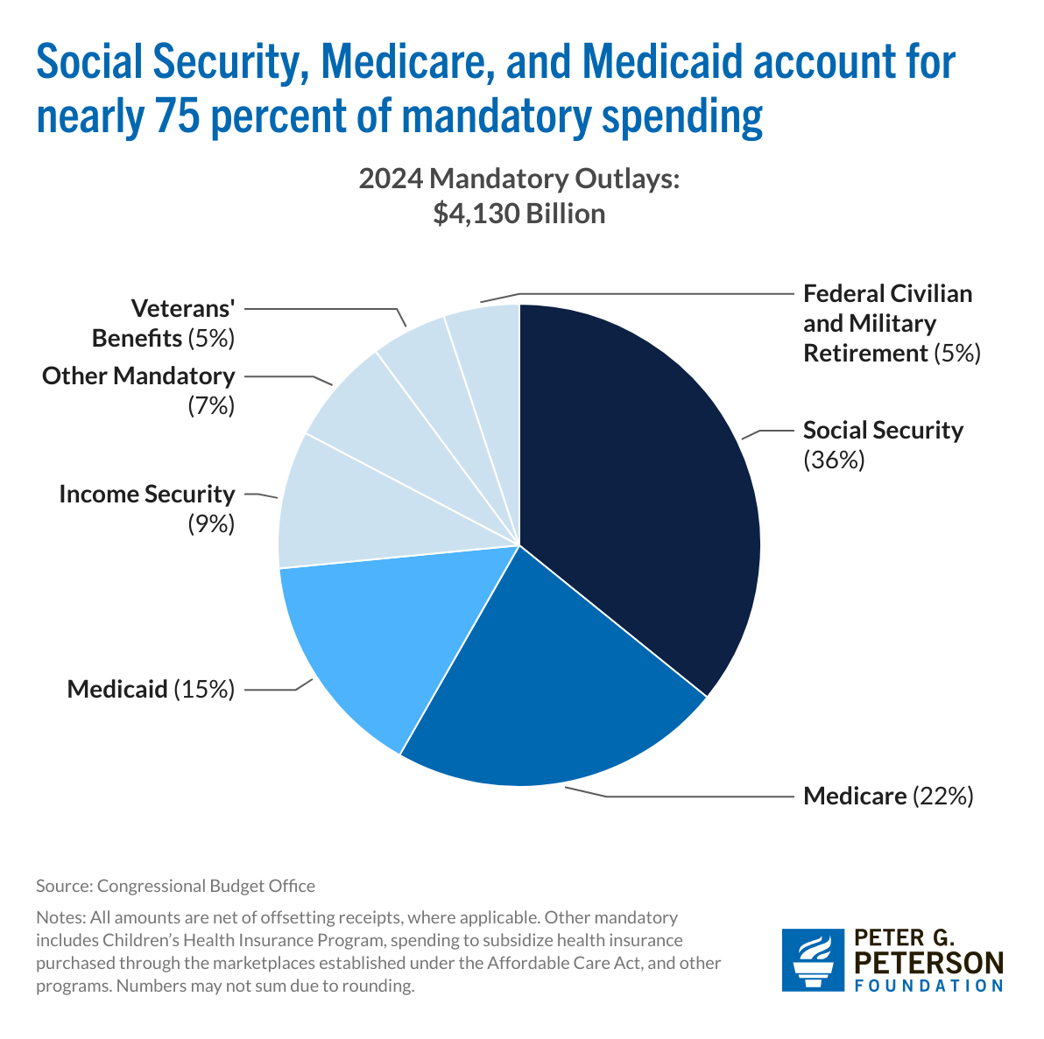
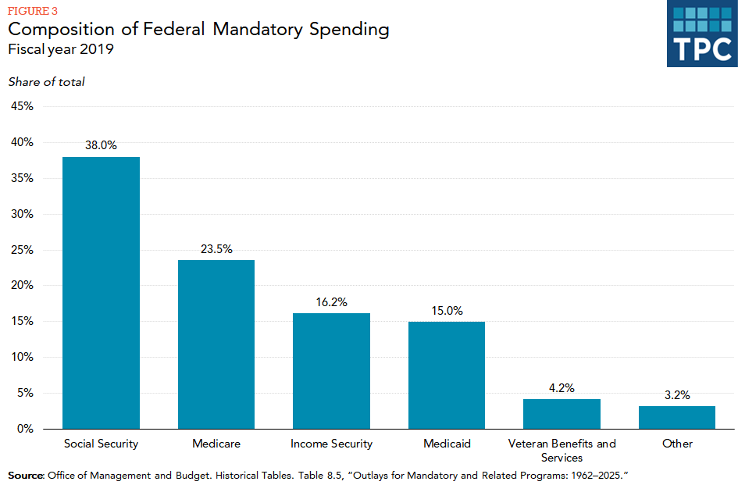

Slide 25
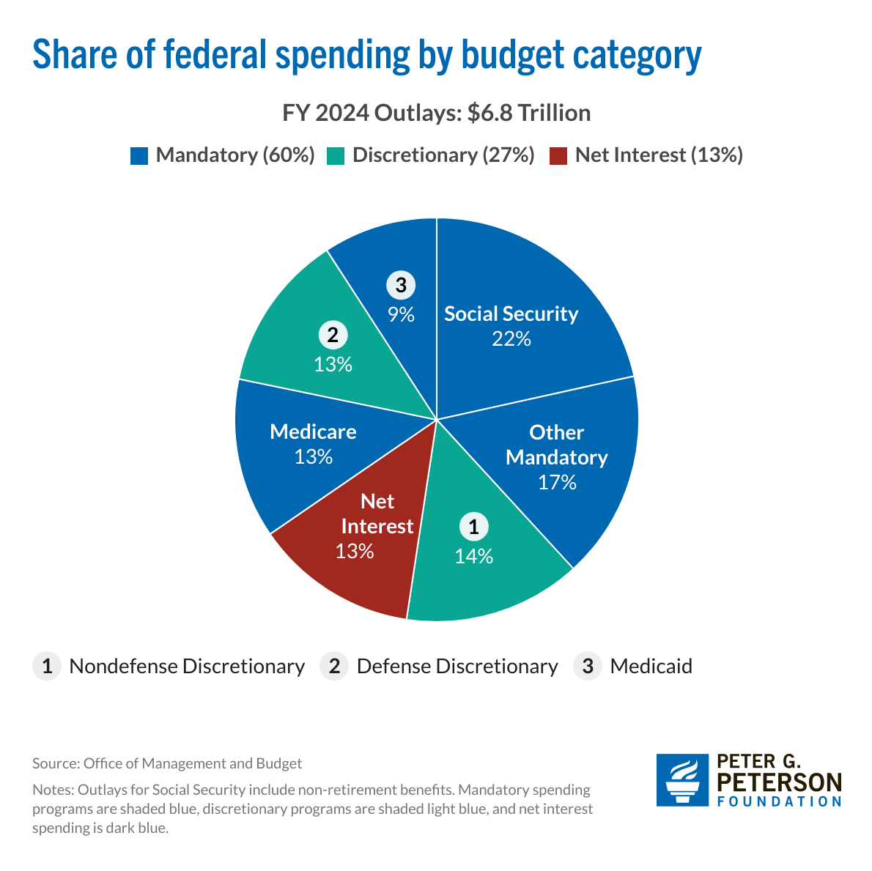
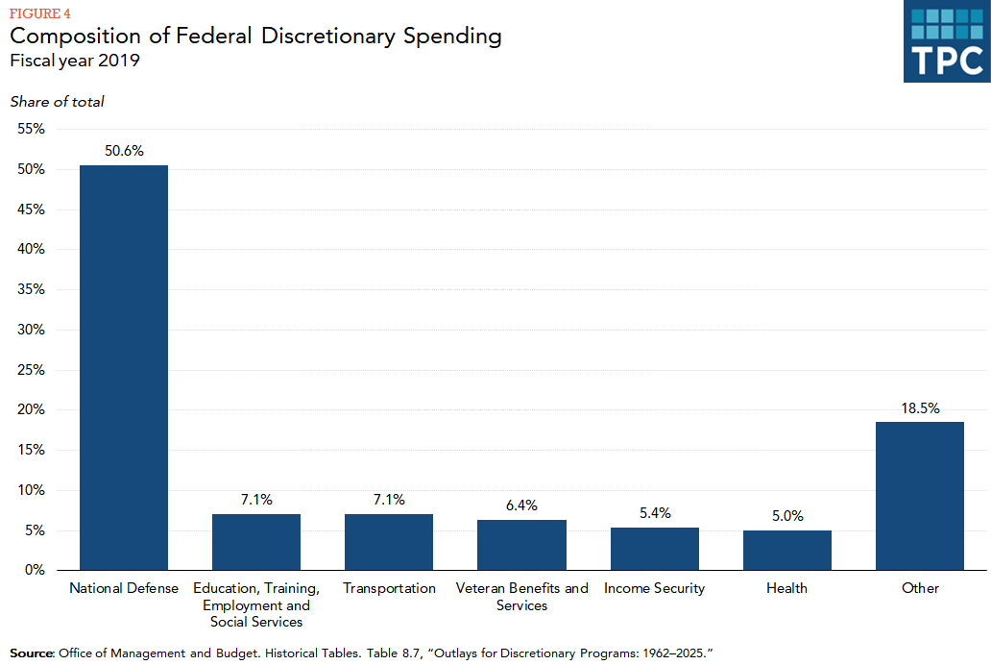

Slide 26
EVERY DOLLAR THAT GOES TOWARDS INTEREST PAYMENTS MEANS LESS RESOURCES ARE AVAILABLE TO BUILD A STRONGER, MORE RESILIENT FUTURE.
WHY DOES THE NATIONAL DEBT MATTER?

Slide 27
