Slide 1
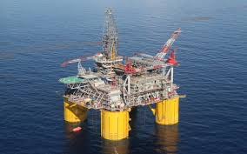
U.S. OIL INDUSTRY

Slide 2
MAJOR OIL PRODUCERS

Slide 3
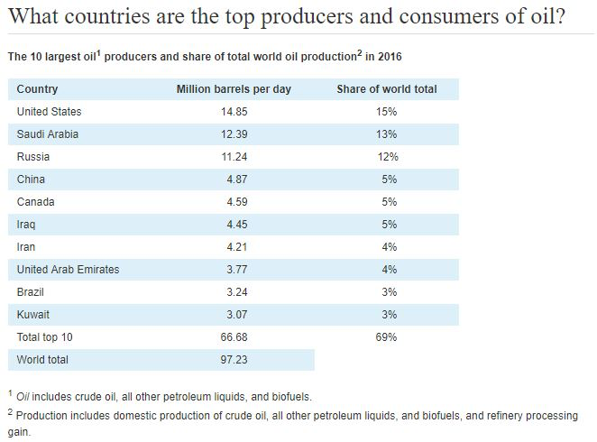
TOP OIL PRODUCERS

Slide 4
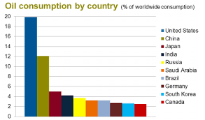
OIL CONSUMPTION BY COUNTRY

Slide 5
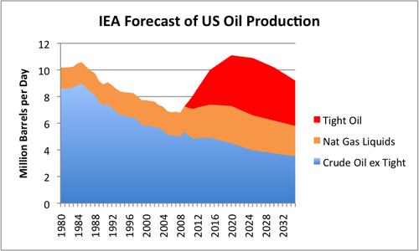
IEA FORECAST US OIL PRODUCTION

Slide 6
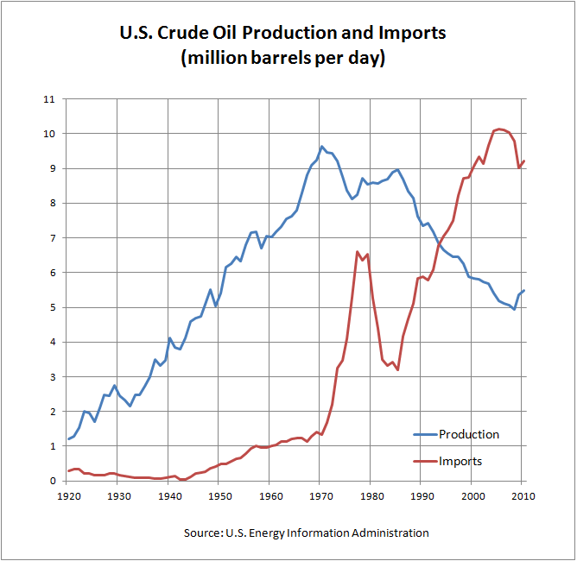
US HISTORICAL OIL PRODUCTION

Slide 7
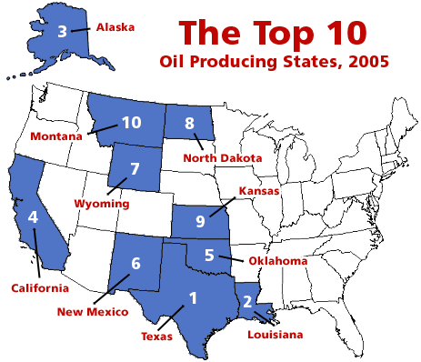
TOP 10 STATES

Slide 9
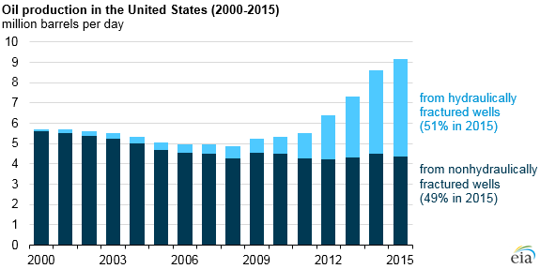
FRACKING IMPORTANCE

Slide 10
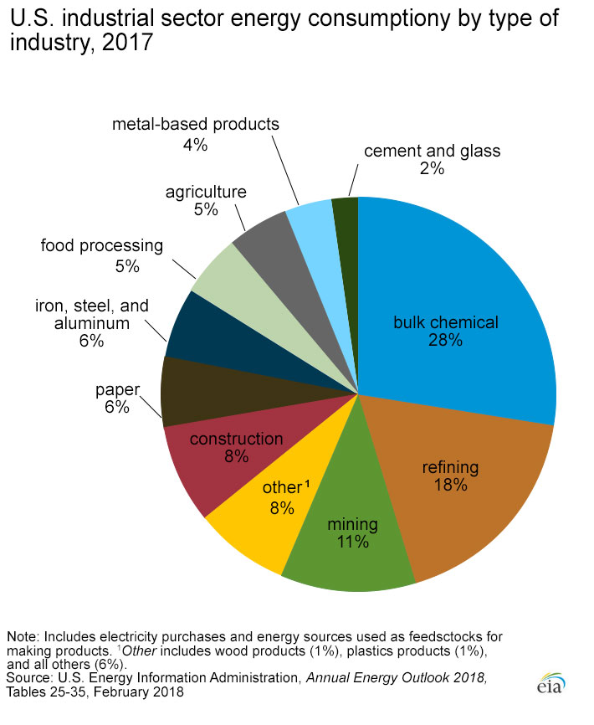
ENERGY CONSUMPTION BY SECTOR

Slide 11
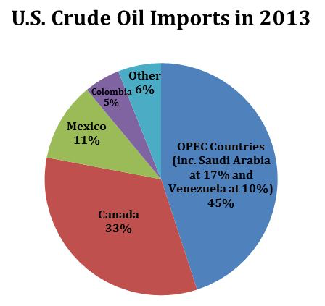
U.S OIL IMPORTS

Slide 12
NEW DRILLING TECHNOLOGIES
FIELDS THAT WERE CONSIDERED DEPLETED ARE NOW BEING DEVELOPED.
SHALE FORMATIONS THAT WERE NON PRODUCTIVE ARE NOW PRODUCTIVE.
SOME OF THE MOST PRODUCTIVE FIELDS IN THE WORLD.

Slide 13
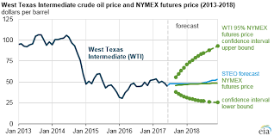
PRICE OF OIL WTI

Slide 14
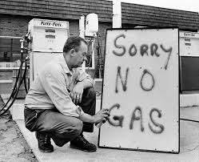
ARAB OIL EMBARGO 1973

Slide 15
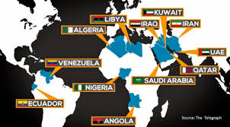
OPEC NATIONS

