Slide 1
U.S. ECONOMIC AND DEMOGRAPHIC HISTORY 1900-PRESENT

Slide 2
FALLING DEATH RATE, MASSIVE IMMIGRATION SPURRED INCREASE
U.S. PERCENT OF WORLD POPULATION FLAT AT 4.5%

Slide 3
U.S POPULATION
U.S. POPULATION GREW 4 FOLD SINCE 1900
ANNUAL RATE OF NATIVE POPULATION GROWTH SLOWED AFTER 1960

Slide 5
FALLING DEATH RATE, MASSIVE IMMIGRATION SPURRED POPULATION INCREASE
U.S PERCENT OF WORLD POPULATION FLAT AT 4.5% SINCE 1900

Slide 7
U.S. POPULATION HAS MOVED WEST AND SOUTH. CALIFORNIA GREW FROM 1.5 MILLION TO 40 MILLION SINCE 1900

Slide 8
SUNBELT/SNOWBELT

Slide 9
1/3 OF U.S. POPULATION NOW LIVES IN SUNBELT.
EXPECTED TO GROW TO ½ OVER TIME

Slide 10
PERCENTAGE WISE WEST GREW THE MOST. SOUTH ALSO ENJOYED MAJOR GROWTH. SUNBELT

Slide 11
WEST ENJOYED THE GREATEST PERCENTAGE
OF GROWTH FOR EVERY DECADE SINCE 1900
SOUTH HAS GROWN SIGNIFICANTLY
SUNBELT BECOMING U.S. MAJOR POPULATION CENTER PRIMARILY BECAUSE OF AIR CONDITIONING

Slide 13
GROWTH FROM NATIVE AMERICANS EXPECTED TO LEVEL OFF THEN DECLINE
MORE THAN 100% OF GROWTH BECAUSE OF IMMIGRATION AND THEIR FERTILITY RATES

Slide 15
URBAN PERCENTAGE GREW FROM 40% IN 1900 TO 75% IN 1990
PROHIBTION PASSED BEFORE 1920 CENSUS WHEN RURAL PROTESTANTS DOMINATED AMERICA
IN ABSOLUTE TERMS RURAL POPULATION HAS REMAINED CONSTANT FROM 1900-PRESENT

Slide 17
SUBURBS GREW FROM ALMOST NONEXISTENT TO 52% IN 2000. AUTOMOBILE WAS THE PRIMARY FACTOR.

Slide 19
DROPPED FROM 5.7 MILLION TO 1.9 MILLION
ARGUMENT AGAINST ESTATE TAX BECAUSE OF INDEPENDENT FARMERS BECOMING LESS SIGNIFICANT

Slide 21
2000 70% WHITE; 12% HISPANIC 12% AFRICAN AMERICAN, ASIAN 2.5%
2050 50% WHITE; 24% HISPANIC, 15% AFRICAN AMERICAN, 8% ASIAN; 5.3% OTHER

Slide 23
1900 97% WHITE
1990 38% WHITE, 31% BLACK, OTHER 31%

Slide 24
NUMBERS ARE IN PERCENTAGES

Slide 26
86% MEN IN WORKFORCE IN 1900.
DECLINED TO 75% IN 1998
63% MEN OVER 65 IN 1900 IN WORKFORCE DECLINED TO 17% IN 1998

Slide 28
NUMBER OF IMMIGRANTS SINCE 1970 HAS GROWN FROM 10 MILLION TO 40 MILLION
PERCENTAGE OF IMMIGRANTS FROM 1970 HAS GROWN FROM 5% TO 13%.
PERCENTAGE OF IMMIGRANTS DROPPED SIGNIFICANTLY FROM 1920-1970 BECAUSE OF DEPRESSION AND WORLD WAR II

Slide 30
UNTIL 1890: MOSTLY GERMANY, IRISH
1890-1920: EASTERN EUROPEANS, JEWS, AND ITALIANS
AFTER 1960 PRIMARILY HISPANICS, THEN ASIANS

Slide 32
1900-1930 ALMOST EXCLUSIVELY EUROPEANS
1930-1965: DIVIDED BETWEEN EUROPEANS AND HISPANICS
1965-1998: MOSTLY HISPANICS FOLLOWED BY ASIANS

Slide 35
DEEP SOUTH: MORE THAN 20%
BORDER STATES, MIDWEST AND NORTHEAST 6-20%
LESS THAN 2 % MOUNTAIN STATES

Slide 37
HIGH SCHOOL GRADUATES ROSE FROM 13% TO 83% POPULATION
COLLEGE GRADUATES ROSE FROM 3% TO 24%

Slide 39
WHITE WOMEN INCREASED BY 45%
BLACK WOMEN INCREASED BY 79%
HISPANIC INCREASED BY 129%
ASIAN-PACIFIC ISLANDER 95%

Slide 41
24% WHITES BACHELOR DEGREE; 14% ADVANCED DEGREE
BLACK 14% BACHELOR DEGREE; 7.6% ADVANCED DEGREE
ASIAN-PACIFIC 31% BACHELOR DEGREE, 23% ADVANCED DEGREE
HISPANIC 10.8% BACHELOR DEGREE; 4.4% ADVANCED DEGREE

Slide 45
PHYSICIANS 1.7 -2.7 PER THOUSAND
LAWYERS 1.4- 3.5 PER THOUSAND
ENGINEERS .5-7.6 PER THOUSAND

Slide 47
PRETTY FLAT UNTIL 1960
HAS RISEN DRAMATICALLY 1960 TO PRESENT—CAUSE: COMBINATION OF REAL GROWTH + INFLATION

Slide 49
GNP PER CAPITA HAS GROWN 9 FOLD SINCE 1950

Slide 51
INCREASED ALMOST 9 FOLD SINCE 1900
AVERAGE PERSON BY OUR DEFINITION LIVED IN POVERTY IN 1900

Slide 54
ASIANS HIGHEST $65,000
WHITE, NON HISPANIC $55,000
ALL RACES $50,000
HISPANIC $38,000
BLACK $32,000

Slide 57
REAL INCOME GREW ABOUT 17%
NOMINAL INCOME GREW ABOUT 48%

Slide 59
TOP 1% GREW 281%
HIGHEST FIFTH GREW 95%
MIDDLE FIFTH GREW 25%
BOTTOM 5TH GREW 16%

Slide 61
TOP 20% GET 46.2% OF ALL INCOME
4TH QUINTILE GET 22.3% OF ALL INCOME
MIDDLE QUINTILE GET 15.6%
SECOND QUINTILE GET 10.6%
BOTTOM QUINTILE GET 5.4%

Slide 62
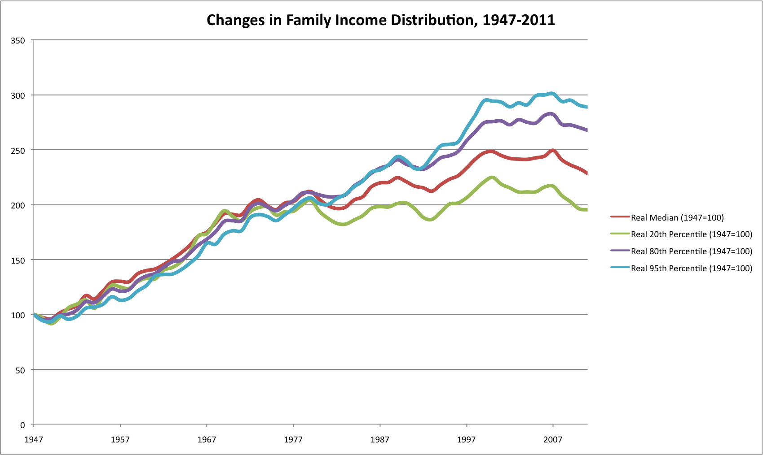

Slide 64
BLACKS WITH LESS THAN HIGH SCHOOL EDUCATION: 20% UNEMPLOYMENT
WHITES WITH LESS THAN HIGH SCHOOL EDUCATION: 14% UNEMPLOYMENT
BACHELOR DEGREE OR HIGHER : BLACKS 6.3% UNEMPLOYMENT AND WHITES 4.3% UNEMPLOYMENT

Slide 67
ROSE FROM 20% IN 1917 TO 37% IN 1989
FELL TO 25% IN 2013

Slide 69
TOP 1% BUSINESS EQUITY AND OTHER REAL ESTATE REPRESENT 47% OF WEALTH
PERSONAL RESIDENCE 9%
MIDDLE 60%: PRINCIPLE RESIDENCE REPRESENT 63% OF WEALTH;
BUSINESS EQUITY AND OTHER REAL ESTATE 9%

Slide 71
NEXT 4 PERCENT GET 12.5%
MIDDLE GET 1.3%

Slide 74
NEW YORK $560,000
FLORIDA $378,000
NEW MEXICO $241,000

Slide 76
TRIPLED SINCE THE YEAR 2000
INCREASED $5.4 TRILLION SINCE JANUARY 2009

Slide 78
OVER 100% DURING WORLD WAR II
AFTER WORLD WAR II DECLINED RAPIDLY.
ALMOST 100% TODAY.

Slide 79
CHANGE IN DEBT LEVEL FROM RECENT PRESIDENTS

Slide 83
REACHED 67% AROUND 2000
DECLINE TO 63% IN 2013

Slide 85
US LABOR FORCE PEOPLE 65 AND OVER LABOR FORCE PARTICIPATION HAS INCREASED FROM 13% TO 18% SINCE 2000 PRIMARILY BECAUSE SOCIAL SECURITY BENEFITS HAVE BEEN PUSHED BACK AND PEOPLE ARE LIVING LONGER

Slide 88
NON-MARRIED WOMEN IN THE LABOR FORCE HAS GROWN FROM 25% IN 1900 TO CLOSE TO 90% IN 2011.
PERCENTAGE OF WOMEN IN THE LABOR FORCE HAS INCREASED FROM 8% TO NEARLY 80%.

Slide 91
UNITED STATES IS BEHIND MANY COUNTRIES
INCLUDING PORTUGAL, CANADA AND SPAIN.

Slide 94
DIVORICE RATE
HIGH DIVORICE RATE AFTER WWII, THEN DROPPED OFF SIGNIFICANTLY.
RISEN CONSIDERABLY SINCE 1975.

