Slide 1
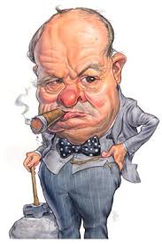
WINSTON CHURCHILL (1874-1965)
ARISTOCRATIC FAMILY DESCENDED FROM LORD MARLBOROUGH
FIRST LORD OF ADMIRALITY WORLD WAR I
DECADE OF WILDERNESS (1929-1939)

Slide 2
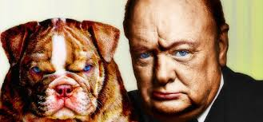
WINSTON CHURCHILL (1874-1965)
TIME MAGAZINE RATED CHURCHILL 2ND MOST IMPORTANT PERSON 20TH CENTURY
WON NOBEL PRIZE IN LITERATURE FOR HIS LIFETIME BODY OF WORK
URGED REARMAMENT

Slide 3
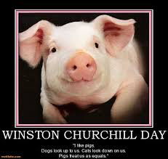
CHURCHILL QUOTES
CATS LOOK DOWN AT YOU
DOGS LOOK UP AT YOU
PIGS TREAT YOU AS AN EQUAL

Slide 4
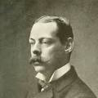
LORD RANDOPH CHURCHILL (1849-1895)
BROKE GROUND FOR NEW BUDGETARY PRESENTATIONS
CREATED NATIONAL UNION OF
CONSERVATIVE PARTY
COLD RELATIONSHIP WITH SON
DIED OF SYPHILIS

Slide 5
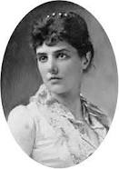
LADY RANDOLPH CHURCHILL 1854-1921
AMERICAN BORN TO LEONARD JEROME
INTRODUCED TO HUSBAND BY KING EDWARD VII
NUMEROUS LOVERS INCLUDING KING
LIMITED ROLE IN WINSTON’S UPBRINGING

Slide 6
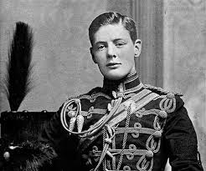
EARLY LIFE
RAISED BY NANNIES
REBELLLIOUS BOY WHO HATED FORMAL EDUCATION
GRADUATED FROM SANDHURST MILITARY COLLEGE

Slide 7
EARLY LIFE
MILITARY CAREER WHERE HE SERVED IN INDIA, CUBA, EGYPT
FOUGHT AGAINST PASHTUN TRIBE IN INDIA
WROTE “THE STORY OF MALAKAND FIELD FORCE”—RECEIVED 600 POUNDS
COVERED BOER WAR, IMPRISONED AND ESCAPED

Slide 8
CHURCHILL JEWISH ADVOCATE
CHURCHILL WAS PRO-SEMITIC WHEN HIS FAMILY AND CONSERVATIVE FAMILY ANTI-SEMITIC
LIFELONG ZIONIST
KNESSET HONORED HIS MEMORY

Slide 9
CHURCHILL QUOTES
YOU HAVE ENEMIES? GOOD.
THAT MEANS YOU HAVE STOOD UP FOR SOMETHING, SOMETHING IN YOUR LIFE
ALL THINGS ARE SIMPLE AND CAN BE EXPRESSED IN SINGLE WORDS: FREEDOM, JUSTICE, HONOR, DUTY, MERCY, HOPE.

Slide 10
CHURCHILL QUOTES
“NEVER, NEVER, GIVE UP”
“SUCCESS IS NOT FINAL. FAILURE IS NOT FINAL: IT IS THE COURAGE TO CONTINUE”
“ITALY HAS A BIG APPETITE BUT ROTTEN TEETH”
WE SHALL DEFEND OUR ISLAND WHATEVER THE COST MAY BE, WE SHALL FIGHT ON THE BEACHES.

Slide 11
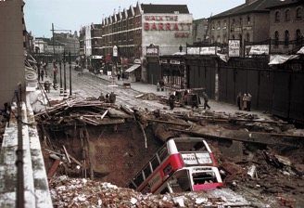
WINSTON CHURCHILL
1933 RECOGNIZED HITLER DANGER
BANNED FROM SPEAKING ON BBC
CHAMBERLAIN TRIED TO TAKE AWAY CONSERVATIVE SEAT EPPING
BOMBING LONDON 1940

Slide 12
EARLY POLITICAL CAREER
MEMBER PARLIAMENT 1900 AS CONSERVATIVE
MOVED TO LIBERAL PARTY 1904
APPOINTED FIRST LORD OF ADMIRALTY 1911
SET UP ROYAL NAVY AIR SERVICE
FAVORED AIRPLANES IN COMBAT AND BEAME PILOT

Slide 13
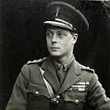
CHURCHILL MAJOR MISTAKES
OVERSAW BRITAIN RETURN TO GOLD STANDARD (1926)
OPPOSED INDIA INDEPENDENCE
WANTED GHANDI TO DIE FOR HUNGER STRIKES
SUPPORTED KING EDWARD VIII

Slide 14
CHURCHILL MAJOR MISTAKES
DIVERTED TROOPS FROM MIDEAST TO DEFEND GREECE FROM NAZIS
FAILED TO PROVIDE ENOUGH TROOPS, AMMUNITION TO PACIFIC CAMPAIGN
PROCRASTINATED ON NORMANDY INVASION

Slide 15
WINSTON CHURCHILL
OPPOSED MUNICH SELLOUT CZECHOSLOVAKIA
URGED CHAMBERLAIN TO NEGOTIATE WITH STALIN PRIOR TO NON-AGGRESSION PACT
LABOUR PARTY WOULD NOT SERVE UNDER CHAMBERLAIN OR HALIFAX

Slide 16
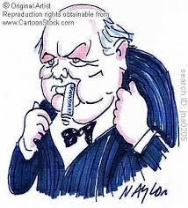
CHURCHILL SPEECH URGING REARMAMENT 1936
GOVERNMENT CANNOT MAKE UP THEIR MIND.
DECIDED TO BE UNDECIDED
ADAMENT FOR DRIFT
ALL POWERFUL FOR IMPOTENCY

Slide 17
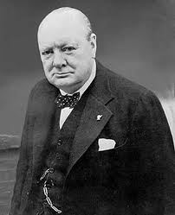
WINSTON CHURCHILL
MAY 10 1940 APPOINTED PRIME MINISTER
MAY 24-28 ARGUED IN WAR CABINET AGAINST ANY NEGOTIATION WITH NAZIS
UPLIFTED BRITISH MORALE WHO HAD BECOME DISCOURAGED DURING PHONY WAR

Slide 18
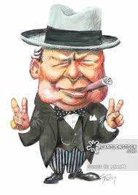
WINSTON CHURCHILL
EXEMPLIFIED SPECTACULAR LEADERSHIP QUALITIES DURING BRITISH LOWEST DAYS
CHAMBERLAIN NEVER DROPED BOMBS ON GERMANY WHILE PRIME MINISTER

Slide 19
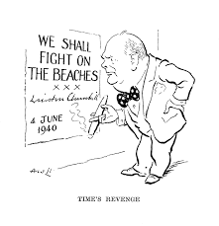
WINSTON CHURCHILL
CONVINCED AMERICA INVADE NORTH AFRICA (1942)
CONVINCED AMERICA INVADE ITALY (1943)
OPPOSED NORMANDY INVASION-1942 AND 1943

Slide 20
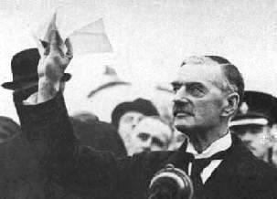
NEVILLE CHAMBERLAIN (1869-1940)
PRIME MINISTER (1937-1940)
WORST OF ALL WORLDS—KNEW NOTHING ABOUT FOREIGN AFFAIRS, BUT WANTED TOTAL CONTROL
ARCHITECT APPEASEMENT POLICIES
HORRENDOUS MILITARY LEADER
HARD-NOSED POLITICAL BOSS

Slide 21
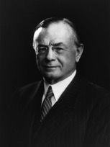
LEO AMERY (1873-1956)
SAW BRITISH EMPIRE AS FORCE FOR JUSTICE AND PROGRESS IN WORLD
WORLD WAR II DEBATE (1939): CALLED OUT TO ARTHUR GREENWOOD “SPEAK FOR ENGLAND—WHICH IMPLIED CHAMBERLAIN WAS NOT!”
MAY 1940 “YOU HAVE SAT TOO LONG FOR ANY GOOD YOU HAVE BEEN DOING. DEPART, I SAY. IN THE NAME OF GOD, GO”

Slide 22
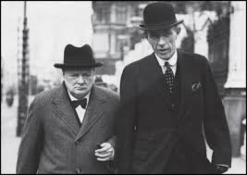
LORD HALIFAX
FAVORED BY CONSERVATIVE PARTY BUT NOT LABOUR OR LIBERALS
FAVORED NEGOTIATING WITH HITLER BY USING GOOD OFFICES OF MUSSOLINI
AMBASSADOR TO U.S.

Slide 23
THE DARKEST HOUR MAY 24-28
HALIFAX AND CHURCHILL ARGUED OVER APPROACHES TO HITLER
HALIFAX WANTED TO SEE WHAT TERMS HITLER WOULD OFFER
CHURCHILL KNEW SLIPPERY SLOPE THAT WOULD END BRITISH INDEENDENCE

Slide 24
CHURCHILL DISTRUST HITLER AND MUSSOLINI
CHURCHILL ARGUED THAT NATIONS THAT GO DOWN FIGHTING WILL RISE AGAIN
CHURCHILL RECOGNIZED THAT THE KEY TO GETTING AMERICAN AID WAS CONFIDENCE THAT BRITAIN WOULD NEVER SURRENDER

Slide 25
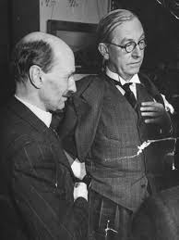
THE DARKEST HOUR MAY 24-28
IF HALIFAX RESIGNED GOVERNMENT WOULD FALL
CHURCHILL HAD 3-2 SUPPORTERS IN WAR CABINET—CLEMENT ATTLEE AND ARTHUR GREENWOOD
CHURCHILL SAID “COUNTRIES THAT GO DOWN FIGHTING ARISE AGAIN!”

Slide 26
DUNKIRK EVACUATION MAY 26-JUNE 4, 1940
338,226 ENGLISH AND FRENCH TROOPS RESCUED
693 BOATS—39 DESTROYERS, 113 TRAWLERS, 300 SMALL CRAFT ETC.
FRENCH BITTERLY RESENTFUL OVER BRITISH EVACUATION
RESTORED BRITISH MORALE

Slide 27
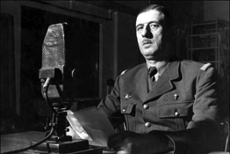
CHARLES de GAULLE (1890-1970)
LEADER FREE FRANCE 1940-1944
AUGUST 1940 CONDEMNED TO DEATH FOR TREASON BY VICHY GOVERNMENT
ADVOCATED MOBILE ARMOURED FORCES IN 1930’S

Slide 28
CHARLES de GAULLE (1890-1970)
“NO NATION HAS FRIENDS, ONLY INTERESTS”
CHURCHILL SAID “DE GAULLE IS THE SPIRIT OF THE ARMY. PERHAPS THE LAST SURVIVOR OF A WARRIOR RACE.”

Slide 29
RETURN TO ADMIRALTY SEPTEMER 3, 1939
HIGHEST-PROFILE MINISTER DURING “PHONEY WAR”
FDR CORRESPONDED WITH CHURCHILL
ADVOCATED MINING NORWEGIAN WATERS TO STOP IRON ORE SHIPMENTS TO GERMANY

Slide 30
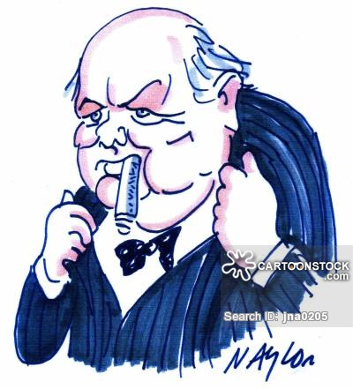
POSITIVE CHURCHILL TRAITS
ENERGY
COURAGE
SINGLENESS OF PURPOSE
RIGHT MAN IN THE RIGHT JOB AT THE RIGHT TIME

Slide 31
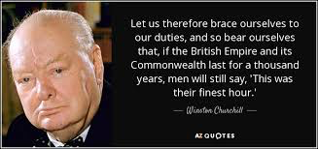
FINEST HOUR
BATTLE OF BRITAIN IS ABOUT TO BEGIN
MADE LORD BEAVERBROOK IN CHARGE AIRCRAFT PRODUCTION
ALLOWED BRITAIN TO GEAR UP PRODUCTION THAT SAVED COUNTRY

Slide 32
FINEST HOUR

Slide 33
CHURCHILL MOBILIZED ENGLISH LANGUAGE
NOTHING TO OFFER BUT BLOOD SWEAT AND TEARS
WE SHALL FIGHT IN FRANCE, WE SHALL FIGHT ON THE SEAS,
WE SHALL DEFEND OUR ISLAND WHATEVER THE COST
WE SHALL NEVER SURRENDER

Slide 34
CHURCHILL MOBILIZED ENGLISH LANGUAGE
IF THE BRITISH EMPIRE AND ITS COMMONWEALTH LAST FOR A THOUSAND YEARS, MEN WILL SAY “THIS WAS THEIR FINEST HOUR”
THIS IS NOT THE END, IT IS NOT THE BEGINNING OF THE END. BUT IT IS THE END OF THE BEGINNING

Slide 35
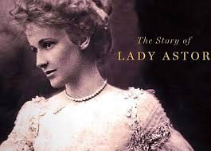
CHURCHILL QUOTE
LADY ASTOR “IF YOU WERE MY HUSBAND, I WOULD POISON YOU.”
CHURCHILL “NANCY, IF YOU WERE MY WIFE, I WOULD DRINK IT”

Slide 36
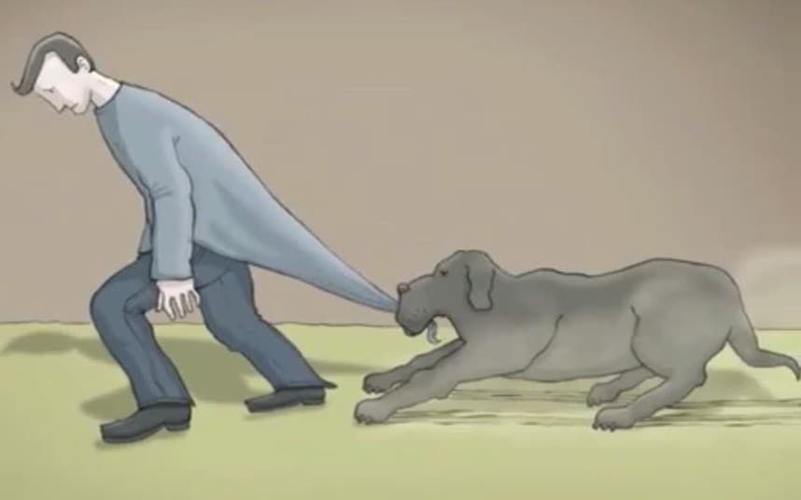
CLINICAL DEPRESSION
CHURCHILL LIFELONG STRUGGLE WITH PROLONGED DEPRESSION
CHURCHILL’S PAINTING ANTI-DOTE
BLACK DOG

Slide 37
RELATIONS WITH U.S.
FDR AND CHURCHILL EXCHANGED 1700 LETTERS AND TELEGRAMS
MET 11 TIMES
HELPED SECURE FOOD, OIL, AND MUNITIONS
ADDRESSED JOINT MEETING OF CONGRESS (12/26/41)

Slide 38
RELATIONS SOVIET UNION
VEHEMENT ANTI-COMMUNIST
“IF HITLER INVADED HELL, I WOULD MAKE FAVORABLE REFERENCE TO DEVIL”
OCT 44: USSR GETS POST WW2
90% SOVIET RUMANIA; 50% YUGOSLAVIA; 10% GREECE

Slide 39
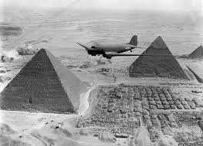
AFRICA CAMPAIGN JUNE 1940-MAY 1943
BRITISH DESTROY ITALIAN DEVISIONS IN LIBYA
SECOND BATTLE EL ALAMEIN (OCT 1942) MONTGOMERY DEFEATS ROMMEL

Slide 40
OPERATION TORCH NOV 1942-MAY 1943
CHURCHILL ADVOCATED JOINT AMERICAN-BRITISH INVASION NORTH AFRICA
VICHY FRENCH FORCES INITIALLY
STUBBORNLY RESISTED
ALLOWED U.S.TROOPS ENGAGE NAZI
SECURE MIDEAST OIL FIELDS

Slide 41
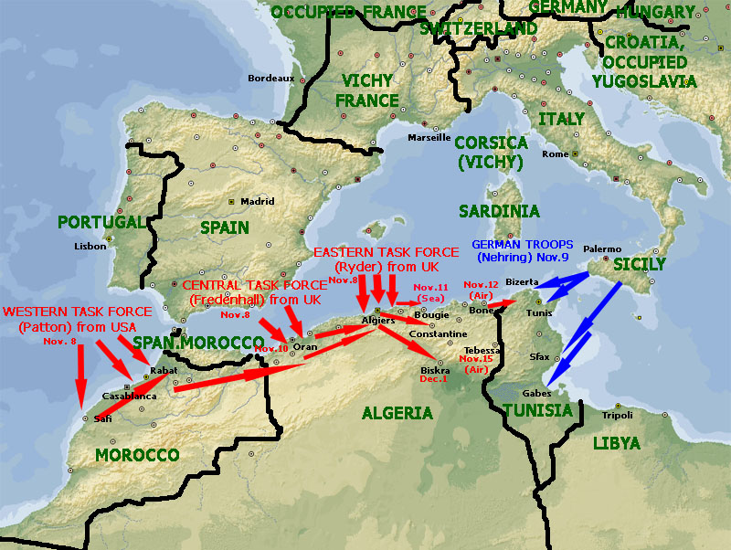

Slide 42
OPERATION TORCH

Slide 43
PACIFIC CAMPAIGN
BRITISH SUFFERED MASSIVE LOSSES
JAPAN CONQUERED HONG KONG; DEC 25, 1941
JAPAN OCCUPIED BANGKOK, THAILAND DECEMBER 9
OCCUPIED ALL MALAYA JANUARY 1942

Slide 44
CHURCHILL ADVOCATED INVADING ITALY
“SOFT UNDERBELLY EUROPE”
ALLIES SUCCESSFULLY CAPTURE SICILY –AUGUST 1943
FALL MUSSOLINI-SEPTEMBER 1943
ITALY SWITCHED SIDES TO ALLIES

Slide 45
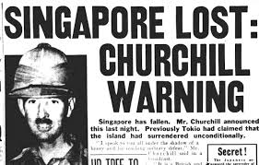
JAPAN CONQUER SINGAPORE
SURRENDER 90,000 INDIAN, AUSTRALIAN, BRITISH TROOPS FEB 16, 1942
CHURCHILL “THE WORST DISASTER AND GREATEST CAPITULATION IN BRITISH HISTORY”

Slide 46
AUSTRALIA
MacARTHUR SUPREME COMMANDER
BATTLE OF CORAL SEA—US PLANES THWART JAPANESE PLAN TO OCCUPY NEW GUINEA—GATEWAY TO AUSTRALIA
BATTLE MIDWAY (JUNE 1942): JAPANESE LOST THEIR FIRST-LINE CARRIER STRENGTH AND BEST PILOTS

Slide 47
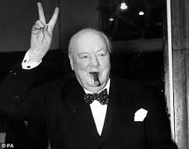
CHURCHILL WINS VOTE OF CONFIDENCE JULY 2,1942
WINS 475-25: FINE EXAMPLE OF DEMOCRACY IN ACTION
FALL OF TOBRUK LIBYA
SUFFERED HEAVY LOSSES TO JAPANESE

Slide 48
NORMANDY INVASION JUNE 6, 1944
HISTORY’S LARGEST AMPHIBIOUS INVASION
FIRST SUCCESSFUL OPPOSED LANDINGS ACROSS ENGLISH CHANNEL IN 8 CENTURIES
EISENHOWER SUPREME ALLIED COMMANDER
6939 VESSELS, 1213 WARSHIPS, 4126 TRANSPORT VESSELS, 864 MERCHANT SHIPS

Slide 49
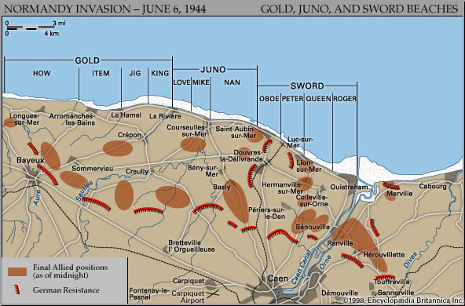
NORMANDY INVASION
UTAH, OMAHA, GOLD, JUNO, SWORD
BY JUNE 19, BRITISH AND AMERICAN FORCES-600,000 54000 VEHICLES, 102,000 TONS OF SUPPLIES.

Slide 50
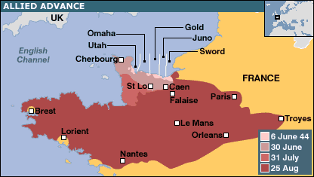
NORMANDY BREAKOUT
BRITISH, CANADIAN, AMERICAN TROOPS BREAKOUT AUGUST 1-14
TAKE PARIS AUGUST 25

Slide 51
DRESDEN BOMBING FEBRUARY 13-15
CHURCHILL ORDERD BOMBING OF CULTURAL IMPORTANCE AND CIVILIAN POPULATION
IMPETUS—STRATEGIC AND TACTICAL TO WIN WAR
“WE NEED TO QUESTION ‘AREA BOMBING’. ATTACKS DO MORE HARM TO OURSELVES AND OUR ALLIES”

Slide 52
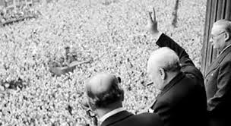
VE DAY MAY 8, 1945
CHURCHILL TOLD HUGE CROWD IN WHITEHALL “THIS IS YOUR VICTORY.”
PEOPLE SHOUTED “NO, IT’S YOUR’S
SANG “LAND OF HOPE AND GLORY”

Slide 53
CHURCHILL DEFEATED JULY 26, 1945
DESIRE FOR POST-WAR REFORM
CLEMENT ATTLEE BETTER SUITED TO LEAD NATION IN PEACE
CHURCHILL REMANED HEAD OF CONSERVATIVE PARTY

Slide 54
CLEMENT ATTLEE QUOTES
DEMOCRACY MEANS GOVERNMENT BY DISCUSSION, BUT IT IS ONLY EFFECTIVE IF YOU CAN STOP PEOPLE TALKING
RUSSIAN COMMUNISM IS THE ILLEGITIMATE CHILD OF KARL MARX AND KATHERINE THE GREAT
50% OF WINSTON GENIUS, 50% BLOODY FOOL. HE WILL BEHAVE LIKE A CHILD

Slide 55
LABOUR GOVERNMENT 1945-1951
MAINTAIN FULL EMPLOYMENT
CRADLE TO GRAVE WELFARE STATE
NATIONALIZED UTILITIES AND MAJOR INDUSTRIES
NATIONAL HEALTH SERVICE
CONSTRUCT NEW TOWNS

Slide 56
LABOUR GOVERNMENT 1945-1951
FINANCIAL SUPPORT HOUSEHOLDS RAISING CHILDREN
FREE SECONDARY EDUCATION
IMPROVE QUALITY OF LIFE IN RURAL AREAS—SECURITY OF TENURE FOR FARMERS, PROVIDE ELECTRICITY AND GAS SERVICES

Slide 57
LABOUR GOVERNMENT 1945-1951
INDIA AND PAKISTAN PARTITIONED- 1947
AVIDLY SUPPORTED MARSHALL PLAN
TURN OVER PALESTINE TO UN
SENT BRITISH TROOPS KOREAN WAR

Slide 58
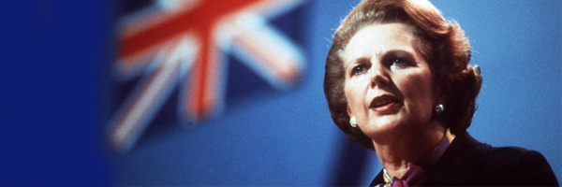
MARGARET THATHER QUOTE SOCIALISM
THE PROBLEM WITH SOCIALISM IS THAT EVENTUALLY YOU RUN OUT OF OTHER PEOPLE’S MONEY

Slide 59
CHURCHILL PRIME MINISTER 1951-1955
MAINLY CONCERNED WITH INTERNATIONAL AFFAIRS, WIDENING COLD WAR
APPOINTED FIRST WOMAN CABINET POST
OVERSAW ELIZABETH II CORONATION 1953
SUFFERED MASSIVE STROKE 1953

Slide 60
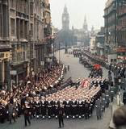
CHURCHILL FUNERAL JAN 30,1965
STATE FUNERAL
BRITISH ROYAL FAMILY ATTENDED
REPRESENTATIVES 112 COUNTRIES

